Slide 1

Database principles & Data Management for JAE Digital
Lifecycle, Quality, Ethics, Security and Legal Compliance

Slide 2
What’s the purpose of this presentation?
The purpose is to provide JAE Digital with a clear understanding of data principles and data management. To explain how data is created, how it should be stored, managed & protected with ethical considerations To outline the benefits to ensuring high quality data and the risks of not following ethical practices, as well as the impacts low quality data may have. To demonstrate how government policies such as GDPR aim to protect data and the consequences of not following them. Finally, the goal is to recommend policies that JAE Digital should adopt to ensure sustained data quality and ethical compliance in support of business operations.

Slide 3

Data Life Cycle
The data life cycle is the complete journey data takes, from collection to eventual disposal.
Data Collection - Gathering data from multiple sources like customer surveys (1–5-star ratings with commentary)
Data Analysis - Extracting insights to identify trends and support decision-making. For example, bad reviews on a product may lead you to fix issues with it.
Data Storage - Saving data in structured formats using relational databases with proper organisation
Data Disposal - Securely deleting data complying with GDPR to protect customer privacy
Data Processing - Cleaning, removing duplicates, correcting formats, and validating for consistency
Data Archiving - Retaining historical data for recurring issues and long-term insights
Data Sharing - Distributing relevant information internally to departments like manufacturing teams
Notes:
The data life cycle is the complete journey data takes, from collection to eventual disposal.
Data collection is a phase where data is gathered from a variety of sources, a commonly utilised method of gathering data is through surveys. For example, a business may prompt individuals who have purchased products or services to respond to a customer satisfaction survey, commonly this will be via a 1–5 Star rating system, this is registered in a numerical format and will often have the option to provide additional written commentary. The numerical rating makes feedback quantifiable which allows for the business to convert subjective ratings into measurable data that can be analysed consistently. When combined with written commentary this allows an organisation to identify trends in consumer behaviour, such as patterns in the volume of reviews indicating an increase of demand, this can allow for a business to respond early ensuring they have proper lead times, for example the time from manufacturing to ensure they have an appropriate stock level to the product being shipped to the consumer. Data like this can allow businesses to make insights to improve underperforming products and expand successful product lines based on evidence from customer responses.
Additionally, if there is a period of abnormality in data such as an influx of low star ratings it may indicate that there is an issue in production of a product, or the courier of the business's product may have started providing an unsatisfactory service. With this informed data, the business could analyse issues within their processes to identify where the problem is occurring and take action to prevent further negative customer experience. Due to this readily available data, they will be able to act fast which may lead to repeat purchases due to high levels of satisfaction on future sales.
Once data is collected it must be stored. Data storage refers to how collected data is saved, where the data is held or if it is in a structured or unstructured format. Structured data is commonly stored in a relational database where tables are used to organise information. In these tables they use primary keys to identify records and link them to related data with foreign keys. In the case of customer reviews, they could be stored in a table with a unique ReviewID which acts as the primary key, while CustomerID and ProductID act as foreign keys linking the review back to the customer product table. Ensuring proper data storage allows for efficient organisation and faster retrieval when data needs to be accessed.
Once data has been collected it must be processed, data processing is the phase where raw data is transformed into usable format, this is done by cleaning the data, this entails removing duplicate data sets, correcting formatting issues and validating entries to ensure consistency. For example, if a customer review is missing a rating or has invalid date format, processing would aim to address these issues before the data is used. Data processing enhances data quality and usability for analysis and decision making.
Data processing is essential to ensure that data that is going to be analysed is reliable or else it can lead to inaccurate insights, for instance duplicate data sets may exaggerate satisfaction or dissatisfaction, while missing ratings could skew the data in the wrong direction and inaccurate dates may make any issue that arises seem like it has occurred earlier or later in the cycle than it has. Inaccuracy in insights could lead JAE Digital to invest resources into problems that are not as significant as they may seem or could even make them misjudge a product's performance. Inaccurate insights could negatively affect the customers experience and the businesses decision making.
Once data is processed it will be fit for analysis. Data analysis is the phase which involves analysing the processed data to extract insights that support a business within their decision making. For example, JAE might use the processed data to identify trends in customer behaviour, tracking satisfaction levels over time or detecting recurring issues that are highlighted in negative reviews. If JAE were to notice an anomaly in ratings dropping significantly for a specific product, this could indicate a fault within their production or the courier that handles their goods. Insights from processed data would help JAE to improve their services, better allocate resources and plan product development. Relevant data can be shared internally with relevant teams. For instance, a department responsible for the manufacturing would receive the important data that indicates potential issues within production so that they can respond to and fix errors in production. Although processed data may eventually become outdated it may be important to archive this data as it can allow for historical insights. If there are recurring issues in production, it would be useful to have this information still on hand to better address problems if they keep arising.
Finally, when data has reached the end of use it must be securely disposed, complying with governance such as GDPR. Whether it is permanently deleting customer records, for instance inactive accounts that may hold sensitive information or disposing of emails which may have sensitive communications, disposal reduces risk and helps to protect customers privacy. Disposing of data ensures that JAE only have data that is necessary or compliant with regulations.

Slide 4

Fundamentals of Data Storage
Structured vs Unstructured Data
Structured Data
Unstructured Data
Organised in relational database tables with rows and columns
No fixed parameters or predetermined format
Uses fixed formats: CustomerID, ProductID, Ratings, Timestamps.
Examples: Comments in reviews, images attached to reviews
Easily searchable and filterable by specific categories
Varies between each customer submission
Difficult to sort into structured tables
Quick analysis and interpretation of data due to data being organised.
Cannot serve as primary keys
Primary keys identify unique records (ReviewID) Foreign keys link related data (CustomerID, ProductID)
Requires specialised processing techniques
Notes:
Data storage is essential to JAE Digital to effectively manage customer data such as feedback, customer information and operational data, it’s important for data to be stored properly when processed so that it can be analysed to gain reliable insights for decision making.
There are two core types of data sets, which are structured and unstructured data.
Structured data can be organised into formats such as CustomerID, ProductID, Product Ratings and Timestamps, this data is arranged in tables with rows and columns allowing for easily searchable and filterable data based on specific categories, due to the ease of access and the structured nature of the data it is able to be analysed and interpreted quickly.
Unstructured data is information that does not have a fixed parameter, an example is a comment included with a star rating for a review, or images added to the reviews as these will fundamentally change between each person. No two people are going to have the exact same image to add to a review or the exact same commentary and therefore it makes it hard to sort into a structured format, by contrast a ProductID is fixed to a specific item and as a result can become what is known as a primary key.
JAE Digital should use a relational database, this type of database stores data in tables which represent a unique entity such as customers, products or reviews, being linked together using keys.
A primary key is the entity identifier for a record within a table.
CustomerID would identify a customer
ProductID would identify a product
ReviewID to identify a review.
Primary keys keep records unique so that they can be easily referenced, they aim to allow individual entries to be tracked accurately.
Foreign keys are a field that reference the primary keys that are held in other tables, they are used to cross reference data between tables allowing tables to be linked together. For example, CustomerID in the reviews table is a foreign key which would link the review to the corresponding customer in the Customer table.
Using primary and foreign keys ensures data integrity, once the database is structured with primary and foreign keys JAE Digital can perform efficient queries on data such as retrieving all reviews for a specific product, they can Match the ProductID against the ReviewID and receive entries only relevant to the specific ProductID they are querying.
﻿
A relational database also allows for scalability. As JAE grows and has vast amounts of data the database can expand while remaining organised. Each table can grow independently of one another while being able to be linked together with foreign keys.

Slide 5
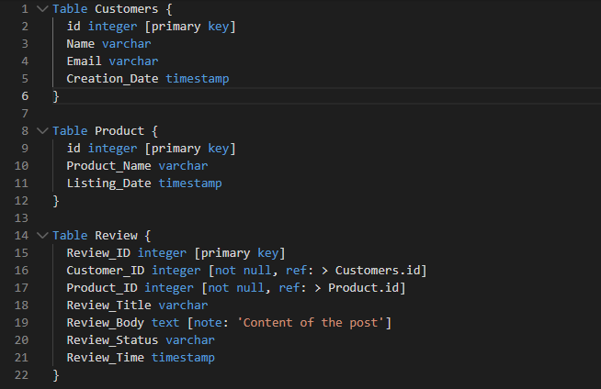
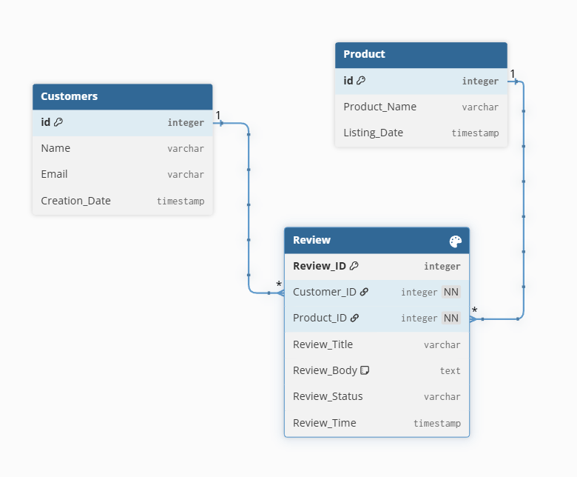
How Do Relational Databases Work?
Example of how PK’s and FK’s Link
& What data do they use?
Structured Data Commonly stored in a relational database where tables are used to organise information. In these tables they use Primary Keys to identify unique records and link them to related data with foreign keys. In the case of customer reviews, they could be stored in a table with a unique ReviewID to identify reviews, a CustomerID to identify customers or a ProductID to identify products. Primary keys keep records unique so that they can be easily utilised. Foreign Keys Foreign Keys reference primary keys in other tables, allowing for links to be made between elements. For Example, CustomerID and ProductID might act as foreign keys linking the review back to the customer or the product. Ensuring proper data storage allows for efficient organisation and faster retrieval when data needs to be accessed. Benefits of Relational Databases: Structured databases enable efficient querying, JAE can quickly retrieve all reviews for a specific product, they can match the ProductID against the ReviewID and receive the relevant entries specific per product they query reviews for, Structured databases are beneficial for growing businesses as the database will remain organised even if product lines expand or demand and therefore reviews increase, each table expands independently.
Reviews are the Primary Key
Whilst Product & Customers are the Foreign Key’s as they link to the Review Table
I Created this in DB Diagram.io
Notes:
See previous slide for notes that pertain to relational Databases / How primary & Foreign keys work https://dbdiagram.io/d – for creation of database

Slide 6

Seven Attributes That Ensure Quality Data
Essential for accurate decision-making for JAE Digital
Accurate
Complete
Consistent
Valid
Data closely reflects customer’s real opinions, Matching reviews to correct ProductID to prevent misleading insights.
All required data is present, all reviews, products, customers and timestamps are accounted for.
Format is the same throughout; Data is always recorded in the same way every time.
Data falls within expected ranges; star ratings must be between 1-5 to ensure usable analysis, outside range = anomalous data.
Timely
Relevant
Unique
Up to date data for responding swiftly to identify drops in ratings, allows for issues to be resolved.
Stored data is meaningful, preventing clutter from unnecessary. Or outdated data.
Data only appears once, no duplicate records, prevents analysis being over inflated or deflated.
Notes:
All attributes effecting data quality Data Quality is the degree in which data is accurate, complete, consistent, valid and reliable for its intended purpose. It’s essential for JAE Digital to have high quality data to make accurate decisions which will result in a positive customer experience. Quality data can be achieved by following the steps listed in the Data Life Cycle Model. If JAE incorrectly follow these steps, it may lead to the insights JAE relies on to make decisions becoming misleading or incomplete due to poor quality data. The main dimensions that help ensure high quality data are Accuracy, Completeness, Consistency, Validity, Timeliness, Relevance and Uniqueness.
Accuracy refers to how closely the data reflects the consumers real opinion, how closely the data is matching to the actual review that was logged. If it was a customer rating and it is recorded incorrectly or the review matches the wrong ProductID JAE may be given an impression that a products performance is worse than it is in reality, which can lead to poor business decision making such as removing a product from production they believe customers are dissatisfied with when in actuality reviews were under the wrong ProductID. If a well-liked product is removed this will further dissatisfy customers and may negatively impact the businesses reputation and ability to gain repetitive sales if their product line is comprised of mainly poor-quality stock.
Completeness refers to all the data required being present and no essential data is missing, every review, every product, every customer and every timestamp must be accounted for. If there is missing data, the data becomes less useful and could skew analysis in too positive or negative of a direction. For instance, if a ProductID was missing, the reviews for said product become useless as they cannot be matched, this means that JAE would not have the data to make insights on said product and they may overlook potential issues a product has as a result.
The purpose of Consistency is to ensure data has an organised format and structure that is the same throughout the database. In the case of JAE Digital this means that their Timestamps, ProductIDs, ReviewIDs and CustomerIDs must be recorded the same way every time. For example, with timestamps it’s important they follow the same system; a timestamp should not be recorded in a format like 1/4/26 and 4/1/26 or alternatively 2026/04/01, it should be consistent throughout as it may lead to unexpected errors when sorting data. Inconsistent data may lead to queries being unreliable if data is improperly indexed, leading to incorrect conclusions on product performance and customer behaviours. When it comes to timestamps the issue that would arise is they may have reviews claiming to be having issues that show a certain date when the timestamp is incorrect and the issues have been fixed previously, leading them to waste resources on a nonissue.
Validity refers to whether data is falling within an expected range, star ratings on reviews must always be between 1-5. If a rating is greater than 5 or lower than 1 the data cannot be used in analysis as it would indicate an anomaly that could sway insights more than expected, additionally it is not a valid set of data as it should not be possible. If JAE did use this invalid data, they may misinterpret customer satisfaction or fail to identify issues.
Timeliness relates to how up to date the data is. Timely data is important in businesses as it is essential to identify trends and satisfy customer expectations. If reviews are not processed early enough and analysed JAE could miss warning signs if there was a drop in rating on a product. This delayed data could involve issues identifying manufacture defects or courier issues, the longer an issue is prevalent the more likely fewer people will become returning customers as they may be dissatisfied with the quality of the product or the service the courier provides, costing JAE money over time due to not reacting swiftly enough. It is important to have timely readily available data to move fast to mitigate any potential loss of business.
Relevance ensures that data that is stored is meaningful to JAE, unnecessary information that would provide minimal insight or outdated information could clutter and slow down accessing the database making analysis take longer. Ensuring data is relevant means that JAE can make accurate decisions in a timely manner.
Uniqueness ensures that each record only appears once, data must not be duplicated. If a review was sent multiple times by accident, it is important to remove the duplicate data set as it could lead to inflated satisfaction scores which creates misleading insights. It is important to remove duplicate data to ensure the integrity of the dataset.

Slide 7
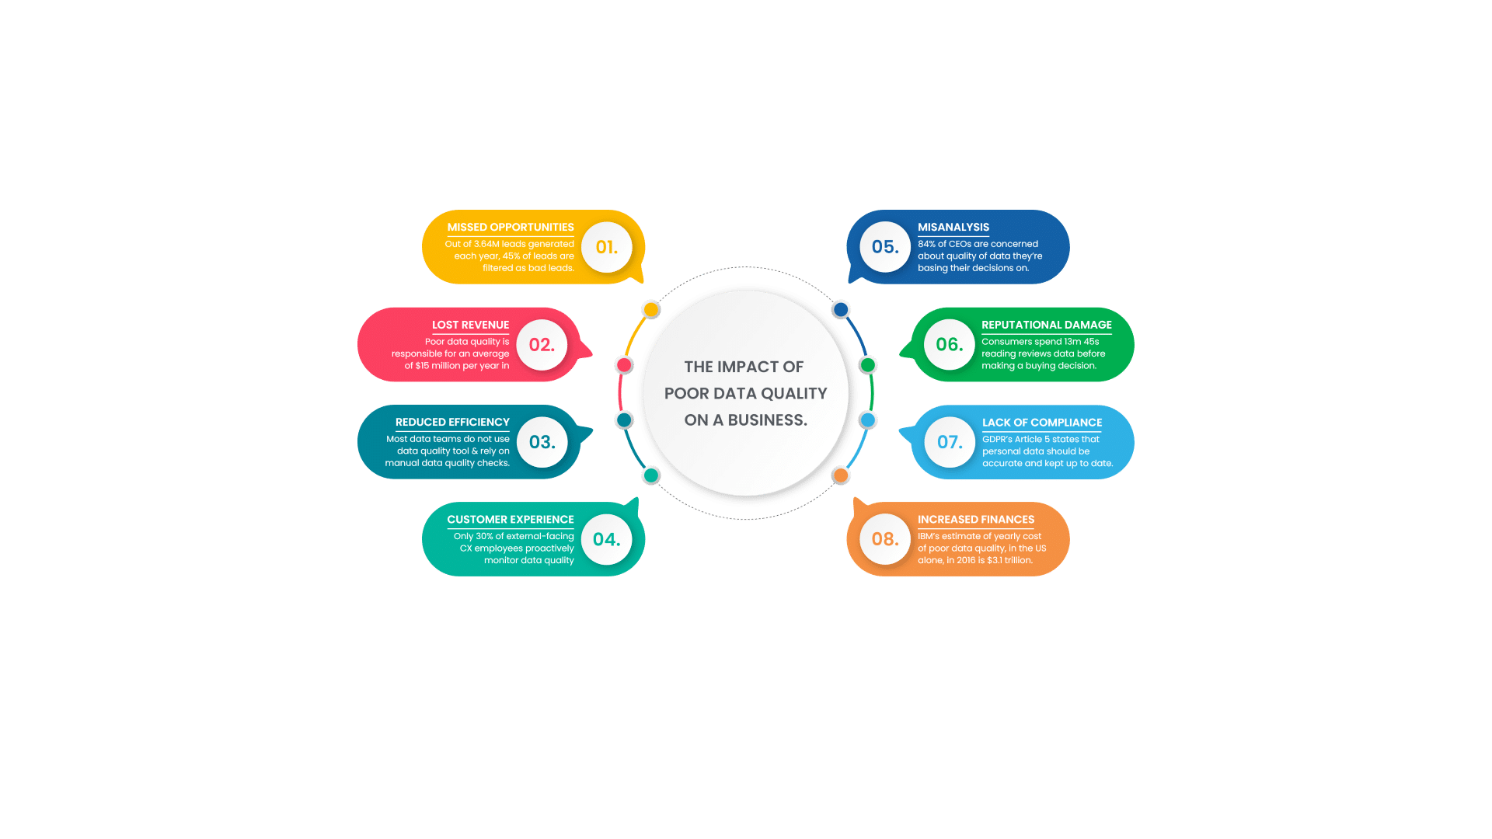
Main Data Quality Challenges
Problems With Validity
Completeness
Consistency Failures
Accuracy Issues
Missing data such as ProductIDs render reviews less useful as they cannot be matched to their data set. JAE would lack insights on affected products, potentially overlooking critical issues as a result.
Data must reflect actual opinions, if a rating is recorded incorrectly or linked to incorrect ProductID it will misrepresent a products performance and can lead to poor decisions. If data is inaccurate JAE may make decisions such as removing well liked product, they believe customers are dissatisfied with. Removing liked products may frustrate customers and damage brand loyalty and reputation which may possibly impact their ability to sell other products as people make assumptions based off their former poor decision making, harming long term business operations.
Inconsistent timestamp formats (1/4/26 vs 4/1/26 vs 2026/04/01) will cause indexing errors and incorrect conclusions about when issues occurred, as querying may be unreliable if data is improperly indexed leading to wasting resources on resolving formatting issues.
Data may not be able to be validated if it falls outside of the expected range. Example: Star ratings on reviews must always be between 1-5. If a rating is greater than 5 or lower than 1 the data cannot be used in analysis as it would indicate an anomaly that could sway insights more than expected. If JAE did use this invalid data, they may misinterpret customer satisfaction or fail to identify issues. As they would believe performance is better than it truly is.
Notes:
Main Data Quality Challenges Accuracy refers to how closely the data reflects the consumers real opinion, how closely the data is matching to the actual review that was logged. If it was a customer rating and it is recorded incorrectly or the review matches the wrong ProductID JAE may be given an impression that a products performance is worse than it is in reality, which can lead to poor business decision making such as removing a product from production they believe customers are dissatisfied with when in actuality reviews were under the wrong ProductID. If a well-liked product is removed this will further dissatisfy customers and may negatively impact the businesses reputation and ability to gain repetitive sales if their product line is comprised of mainly poor-quality stock.
Completeness refers to all the data required being present and no essential data is missing, every review, every product, every customer and every timestamp must be accounted for. If there is missing data, the data becomes less useful. For instance, if a ProductID was missing, the reviews for said product become useless as they cannot be matched, this means that JAE would not have the data to make insights on said product and they may overlook potential issues a product has as a result.
The purpose of Consistency is to ensure data has an organised format and structure that is the same throughout the database. In the case of JAE Digital this means that their Timestamps, ProductIDs, ReviewIDs and CustomerIDs must be recorded the same way every time. For example, with timestamps it’s important they follow the same system; a timestamp should not be recorded in a format like 1/4/26 and 4/1/26 or alternatively 2026/04/01, it should be consistent throughout as it may lead to unexpected errors when sorting data. Inconsistent data may lead to queries being unreliable if data is improperly indexed, leading to incorrect conclusions on product performance and customer behaviours. When it comes to timestamps the issue that would arise is they may have reviews claiming to be having issues that show a certain date when the timestamp is incorrect and the issues have been fixed previously, leading them to waste resources on a nonissue.
Validity refers to whether data is falling within an expected range, star ratings on reviews must always be between 1-5. If a rating is greater than 5 or lower than 1 the data cannot be used in analysis as it would indicate an anomaly that could sway insights more than expected, additionally it is not a valid set of data as it should not be possible. If JAE did use this invalid data, they may misinterpret customer satisfaction or fail to identify issues.
Timeliness relates to how up to date the data is.

Slide 8
Ethical Considerations In Data Management
JAE Digital must make ethical considerations when collecting, storing processing and analysing customer data. If JAE does not follow ethical principles customers may lose trust, harming reputation.
Transparency is fundamental
Customers should not feel that their information is acquired without justification. To be ethical JAE must be open about the data collected, giving clear explanation for why it is needed and how data will be utilised. Consumers should be provided with information on how their feedback will be used if at all. Collecting information without transparency undermines trust.
Fairness & Non-discrimination
JAE must ensure that data is processed without discrimination, biased data can lead to unfair outcomes, incorrectly identifying customer satisfaction due to biased interpretation, or denial of a review. Failing to accept accurate feedback can disadvantage customers as real issues brought up may not be taken with proper care.
Right to Erasure
Security Measures
Customers should have the right to erasure, controlling their personal data. They should have the right to request their data being deleted, especially if it is no longer needed or they no longer wish for it to be stored. This is an ethical and a legal requirement under GDPR. JAE Digital must ensure that customers can easily request to have their data removed.
It is recommended that JAE also implement strong security measures to safeguard customers personal information, this can be done by encrypting data to obfuscate it so that only those who have a matching key can access it or having access levels so that only high-level trusted employees can access it.
Notes:
JAE Digital must make ethical considerations when collecting, storing processing and analysing customer data. Ethical data management ensures that customers are treated fairly and that their information is handled with the utmost importance. If JAE do not follow ethical principles customers may lose trust in the business which would harm JAE's reputation. Consumers are more likely to engage with businesses that respect their privacy and provide assurances that their information will be protected. Transparency in data collection demonstrates a commitment to protecting sensitive personal information.
Customers should not feel that their information is acquired without justification. To be ethical JAE must be open about the data collected, giving clear explanation for why it is needed and how the data will be utilised. When a customer leaves a review, they should be provided with information on how their feedback will be used if at all, or if it will be used for something like improving a product. Collecting information without transparency undermines trust.
JAE must ensure that data is processed without discrimination, biased data can lead to unfair outcomes, incorrectly identifying customer satisfaction due to biased interpretation, or denial of a review. Failing to accept accurate feedback can disadvantage customers as real issues brought up may not be taken with proper care.
It is recommended that JAE also implement strong security measures to safeguard customers personal information, this can be done by encrypting data to obfuscate it so that only those who have a matching key can access it or having access levels so that only high-level trusted employees can access it.
Additionally, customers should have the right to erasure, controlling their personal data. They should have the right to request their data being deleted, especially if it is no longer needed or they no longer wish for it to be stored. This is an ethical and a legal requirement under GDPR. JAE Digital must ensure that customers can easily request to have their data removed.

Slide 9

Preventive and Mitigation Strategies for Data Quality and Ethical Issues
Mitigation Strategies For Ethical Issues
Preventative Strategies For Ethical Issues
Mitigation Strategies For Data Quality
Preventative Strategies For Data Quality
Transparency with Customers Explain what data is collected and why. Data Minimisation Collect only necessary information Bias Reduction Ensure data is fair, representative, and non‑discriminatory
Standardised Data Entry Consistent formats for timestamps, IDs, and other fields. Defined Database Structure Clear PKs and FKs (ProductID, CustomerID, ReviewID) Input Validation Rules Ensure range is accurate (1–5 stars), reviews must match correct ProductID. Staff Training Guidance on accurate, ethical data handling Automated Error Detection Duplicate/missing entry alerts / checked before data is saved as to not influence analysis.
Audit Logging Tracks who changed what and when. Routine Data Checks Identify and fix issues before analysis. Regular Backups Allow data restoration if corrupted or lost.
Incident Response Plan Rapid action for ethical concerns. Customer Notification & Remediation Inform affected users if data breach occurs and secure data swiftly. Ethical Auditing To Identify weak areas and improve practices. Staff Incentives for Compliance Reward consistent ethical and legal behaviour, keeps staff accountable and encourages employees to follow ethical frameworks.
Notes:
Preventative strategies for data quality:
To ensure quality data entry it’s important to address data quality at the source, identifying how data will be stored upon creation, whether it’s formatting for timestamps dates or in relational databases defining Primary Foreign keys such as ProductIDs CustomerID ReviewID or other applicable entries per business. Standardising data entry helps to prevent inconsistencies and reduces the likelihood of invalid data being input, it also reduces the likelihood of incomplete entry as employees will have training and strict guidelines on the format to follow.
However, people make mistakes regardless of their tenure within a role, as a result it’s a good idea to implement checks that validate entry to ensure data falls in the defined boundaries and follows the format that is a standard. For example, star ratings must require a rating from 1 to 5 and ProductID must match the correct products. Validation aims to stop data that is incorrect from entering the system and aims for it to be corrected, this reduces the need for intervention at a later date that may result in unnecessary expenditure which would be wasted on the time taken to fix issues, furthermore it’s essential that staff are regularly trained in hands on data handling to teach them how to responsibly enter data that adheres to ethical guidelines while keeping data accurate, regular training ensures that employees understand their impact on ensuring high quality data and customer trust.
Another way to prevent low quality data similar to validation is with automated error detection systems. Having a way for duplicate entries or missing entries to be flagged would be beneficial as it could alert employees to issues before they become a problem and stop duplicate or missing fields potentially skewing data after analysis.
Mitigation strategies for data quality:
JAE should consider having an audit logging system that routinely checks and tracks to see who edits or adds data and when they have edited, audit logging attempts to keep staff members accountable if they make a mistake or intentionally edit data to cause harm, additionally JAE should regularly check the database for issues so they do not pile up too much, they should remove errors before any analysis takes place so that the data set represents what they are looking for likely customer insight to improve as a business.
Additionally, they should have regular backups on data if corruption occurs. This is necessary to minimise downtime and permanent data loss.
Preventative strategies for Ethical Issues:
JAE should be public with the data they collect; they should provide a reason for why and how they will use the data; they should only collect necessary data too as to not make their data set too large and confusing, ensuring they do not hold too much irrelevant information, JAE must ensure that data that is collected is free from bias.
Mitigation strategies for Ethical Issues:
If JAE had issues with a data breach or concerns regarding ethical issues, they must have a plan in place to respond quickly, this is known as an incident response plan. This response plan should be in place to swiftly help them to identify an issue and resolve it, whether it is a data leak by securing their systems and notifying affected customers staff or an ethical issue relating to the data they hold such as a right to erasure request they must have a plan to act upon the information fast, to ensure that JAE is compliant with regulations such as GDPR and follows ethical principles they could choose to implement auditing that helps to address areas where they can improve and rewards incentivises employees who consistently achieve good ethical and legal practices.

Slide 10
Potential Policies to Sustain Data Quality and Ethical Standards
Data Governance Policy Establishes who owns certain data, responsibilities, and rules for how data must be handled across the business. Data Quality Policy Defines required standards for accuracy, completeness, consistency, and validation before data enters the system. Ethical Data Use Policy Ensures transparency, fairness, minimal data collection only what is required, and responsible handling of customer information as to build a consumer to business relationship.
GDPR Compliance Policy Outlines procedures for consent, right to erasure, secure storage, breach reporting, and lawful processing. Security & Access Control Policy Uses RBAC, encryption, and audit logging to protect data and maintain accountability. Training & Awareness Policy Requires regular staff training on data entry, ethics, and legal responsibilities.
Notes:
JAE Digital should follow the Ethics in Data & AI Framework outlined by the UK Government; the framework provides a set of principles and activities to guide the responsible development and use of data and artificial intelligence in the public sector, JAE must follow ethical guidelines as not doing so has its consequences, one consequence is legal repercussion, as ethical standards often align closely with laws and regulations that are designed to protect the safety of individuals personal data, which is outlined under as GDPR, a result failure to follow these ethical guidelines can have consequences that follow, such as fines, imprisonment, loss of licenses or even shutdowns, ignorance when it comes to ethical guidelines can cause significant harm to producers, such as those who’re tasked to create produce in a potentially unfit for purpose conditions, with low salary. or individuals that use a service, such as a medical services that handle sensitive medical data or may make preconceived judgements based on biases relating to personal characteristics such as race or sexuality. Core principles of the Ethics framework include Transparency, Accountability, Fairness, Privacy, Safety, Societal impacts and Environmental sustainability. These principles push businesses to ensure that data is handled responsibly and that the impact of data is treated with care. To sustain high data quality and ethical standards, JAE Digital should implement internal policies that align with the government’s ethical framework as being compliant with ethical frameworks will help ensure consistent responsible data management. Policies such as Ethical Policies act as a foundation to advise how data should be collected and used within a business. Ensuring that ethics are at the forefront of business considerations is excessively important throughout the process rather than it being a secondary thought. JAE can reduce the likelihood of unethical behaviour by making guidelines a requirement for staff to follow. It’s important they put an emphasis on following their principles and reward and punish behaviours accordingly as the accidental misuse of data or poor-quality data entry may negatively affect customers or the businesses' ability to operate appropriately. JAE should regularly review their policies as well to ensure they remain aligned with the current legislation as well as the current ethical expectations that may not be mentioned. Policies must adapt to address new issues. Policies JAE may look to implement are: Data Governance Policy Establishes ownership, responsibilities, and rules for how data is handled across the business. Data Quality Policy Defines required standards for accuracy, completeness, consistency, and validation before data enters the system. Ethical Data Use Policy Ensures transparency, fairness, minimal data collection, and responsible handling of customer information.
GDPR Compliance Policy Outlines procedures for consent, right to erasure, secure storage, breach reporting, and lawful processing. Security & Access Control Policy Uses RBAC, encryption, and audit logging to protect data and maintain accountability. Training & Awareness Policy Requires regular staff training on data entry, ethics, and legal responsibilities.

Slide 11
Relevant Data Management Legislation
Core GDPR Principles
Key GDPR Requirements
Lawfulness, Fairness & Transparency JAE must explain why data is collected and how it will be used. Data subjects must give consent for processing their personal data for specific purposes. JAE can process data lawfully through disclaimers that creating reviews, purchasing products, or providing contact information means agreeing to data being forfeited within legal parameters. Purpose Limitation: Data must only be used for the purpose that it is collected for, such as analysis to infer consumer insights such as satisfaction of product, if JAE want to use data for a reason that they’ve not clearly stated to consumers upon the point of collection that they will use their data to aide their research then they must issue a new policy that includes the data policy as well as informing of changes they have made.
Right to erasure Customers can request data deletion Data minimisation Collect only necessary information Transparent processing Clear communication about data usage Secure storage Appropriate technical measures required Breach notification Report incidents within 72 hours Consent Explicit permission for data collection
Consequences of Non-Compliance ICO can impose significant penalties including fines, imprisonment, license loss, or business shutdowns for GDPR violations. 2024 data shows substantial fines for inadequate data protection. Secure disposal at lifecycle end reduces risk and protects privacy. Source: ICO penalties guidance 2024;
Notes:
JAE digital as well as other business that hold data within the UK & EU, the main legislation that demands compliance is the General Data Protection Regulation (GDPR) GDPR protects consumers by governing how an organisation can collect, store, process and dispose of personal data. It aims to ensure that organisations handle customer information lawfully, fairly and transparently, which contributes to the protection of individual’s fundamental rights and freedoms according to the UK 2016 GDPR Legislation, examples of data that GDPR applies to is data that can identify an individual, or in the case of JAE one of their consumers, they must protect names, email address, review content or even purchase history. Core principles under the GDPR include: Lawfulness, relating to fairness and transparency in processing & collection. JAE must explain why data is collected and how it will be used. The data must abide by rules set out in the GDPR an example of a rule that defines lawfulness is ‘the data subject has given consent to the processing of his or her personal data for one or more specific processes’, JAE can be lawful by having a disclaimer to limit liability that by creating a review, completing a consumer and business contract via purchasing product, or providing your contact information with an account you hold with them that you agree to be bound by whatever they choose to do with the data in legal parameters. Purpose Limitation: Data must only be used for the purpose that it is collected for, such as analysis to infer consumer insights such as satisfaction of product, if JAE want to use data for a reason that they’ve not clearly stated to consumers upon the point of collection that they will use their data to aide their research then they must issue a new policy that includes the data policy as well as informing of changes they have made. Consequences of Non-Compliance ICO can impose significant penalties including fines, imprisonment, license loss, or business shutdowns for GDPR violations. 2024 data shows substantial fines for inadequate data protection. Secure disposal at lifecycle end reduces risk and protects privacy. Sources: ICO penalties guidance 2024; Information Commissioner’s Office Data Protection Fining Guidance: Information Commissioner’s Office (ICO) (n.d.) Data Protection Fining Guidance. Available at: https://ico.org.uk (Accessed: 8 January 2026).
GDPR Article 1 – Subject‑matter and objectives: European Union (2016) Regulation (EU) 2016/679 (General Data Protection Regulation), Article 1. Available at: https://www.legislation.gov.uk/eur/2016/679/article/1 (Accessed: 8 January 2026).
GDPR Article 6 – Lawfulness of processing: European Union (2016) Regulation (EU) 2016/679 (General Data Protection Regulation), Article 6. Available at: https://www.legislation.gov.uk/eur/2016/679/article/6 (Accessed: 8 January 2026).
GDPR Article 8A – Purpose limitation: European Union (2016) Regulation (EU) 2016/679 (General Data Protection Regulation), Article 8A

Slide 12

The importance of security policies
Utilising the CIA Triad for visualisation
Confidentiality
Role-Based Access Control (RBAC) ensures only authorized individuals access data often hierarchically based on job description. Senior staff control larger datasets; lower-level employees may write to database but cannot push changes without higher approval. This ensures extra verification, fewer unauthorized edits, less corruption risk, and accountability as changes are audited.
Integrity
Audit logging maintains data accuracy by prompting notifications when data is tampered with, helping identify and validate alterations. ICO/NCSC GDPR guidance requires measures to prevent unauthorised processing and accidental loss, destruction, or damage. Controlled changes maintain reliable, accurate data.
Availability
Data must be accessible to authorized users when needed for decision-making. Unavailability prevents crucial insights. Threats include ransomware, encryption, or deletion by threat actors, damaging customer trust. Regular backups and recovery plans minimise downtime, allowing for services to remain operational.
Notes:
Security policies shape how an organisation goes around protecting data, policies identify who can access specific data and aim to mitigate misuse. The CIA Triad is an integral concept when it comes to secure data management, data security policies provide a structure that ensures data is managed in a way that prevents threat actors from gaining access and potentially altering, exfiltrating or destroying data. JAE Digital must implement security policies to keep their data confidential, to maintain its integrity and to make sure it’s readily available on request, by following the CIA triad as a principle they can maintain trust between customers and comply with legal governance.
To ensure Confidentiality it may mean that Role Based Access Control(RBAC) is implemented so that only authorised individuals will be able to access the data, often being hierarchical depending on job description, senior staff may have access to control larger datasets as their responsibilities require it, while lower level employees may not have full control over a database, they may only be able to write to a database but not push changes without approval from someone with a higher level of access. If JAE employed a system such as RBAC it would ensure an extra level of verification before making sure that the data being saved is valid and compliant with ethical guidelines and GDPR. Its impact on data is significant, it means that there are fewer unauthorised edits, less risk of corruption and it holds those who make edits accountable as their changes are audited before being pushed, this improves data integrity over time and supports consistent, reliable data management.
Maintaining integrity can also be done by audit logging, to ensure that data remains accurate by prompting notification when data is tampered with, helping to ensure that anything that has been altered can be identified and validated. The ICO states that organisations must process personal data securely using appropriate technical and organisational measures, additionally the ICO & NCSC GDPR Guidance reinforces that organisations must implement ways to maintain secure processing preventing unauthorised modification of data, as to be GDPR compliant they require personal data to be ‘processed in a manner that ensures appropriate security of the personal data, including protection against unauthorised or unlawful processing and against accidental loss, destruction or damage, using appropriate technical or organisational measures’. These requirements support data integrity by preventing unauthorised modification, which ensures that changes are controlled and monitored, which is what audit logging enables by monitoring and keeping those accountable that deal with data.
Availability in data relates to data being easily accessible to those who are authorised to do so when it's needed, availability is essential as data that is held, namely customer reviews, product information and customer information, plays a crucial role in decision making, if this data is unavailable important insights cannot be made to support decision making as there is no information that informs them on what needs improving.
Furthermore, if data is improperly secured it may be vulnerable to threat actors which may result in a loss of data if they exfiltrate, ransom, encrypt or entirely delete information, this will have a lasting impact, and incorrect insights may be made due to their influence because the data is not available. This is damaging for maintaining customer trust as JAE need to be able to analyse customer feedback to respond to issues, additionally JAE would be required to make a statement on any data breach, and this could cause a loss of consumer trust which may lead to capital being lost and the business suffering as consumers are not willing to become repeat buyers of their products or services. To ensure that data is always available it's essential that they have regular backups of the data and mitigation methods such as a recovery plan in place to know how to respond to a loss of data. Backups make it so that data can be completely or partially restored if it's entirely lost or corrupted, while the plan is indicative of how you go about utilising this backup. Having these measures in place minimises downtime for JAE and maintains the continuity of their services. Availability can further be strengthened by monitoring potential points of failure so that issues that do occur hold people accountable, ensuring that problems are not repeated. ICO UK GDPR guidance and resources: Information Commissioner’s Office (ICO) (n.d.) UK GDPR guidance and resources. Available at: https://ico.org.uk/for-organisations/uk-gdpr-guidance-and-resources/ (Accessed: 10 January 2026).

Slide 13
Conclusion & KEY takeaways
Data is a core asset for JAE Digital and must be managed carefully across every stage of the data lifecycle.
Structured data and relational databases allow accurate links between reviews, customers, and products, making analysis reliable.
High‑quality data is essential; issues with ProductIDs, timestamps, or ratings can distort insights and lead to poor business decisions.
GDPR requires transparency, minimised data collection, secure storage, and support for the right to erasure to avoid fines and reputational damage.
Security measures such as the CIA Triad, RBAC, and audit logging protect data and keep staff accountable.
Validation rules, auditing, and staff training help maintain consistent, accurate, and responsible data handling.
Notes:
Data is a core asset for JAE digital, managing data effectively means closely monitoring every stage of the data lifecycle, from collection to processing, storage, analysis, sharing, archiving, and eventual disposal.
Every stage of the data lifecycle has risks, and each stage influences how the business may make insights, as a result, the business requires a high quality of data to provide the best insights and carry out a high level of service.
The use of structured data and relational databases provides the ability to easily analyse data as Primary Keys and Foreign Keys allow for links between tables to be made, relationships between reviews, customers, and products can enable data to be linked and interpreted accurately.
Without structured data, JAE Digital would be unable to transform raw or inconsistent data into a format that is useable for analysis. Unstructured information varies widely between individuals and cannot be quantified or compared in the same way as structured data such as ratings. As a result, using unstructured data would take more time and may not lead to accurate insights being made.
Data quality is essential for determining how useful the information of a database is. Accuracy, completeness, consistency, validity, timeliness, relevance, and uniqueness, are required for dependable information. Issues revolving around ProductID, Timestamps, or anomalous ratings will lead to poor-quality data, which distorts outcomes as they may lead to inaccurate insights, insights directly influence business decisions and poor insights may lead to misinterpretation of consumer beliefs, which could cause incorrect product changes or defects may be overlooked, this harms the user experience and potentially the businesses operation as they may fail to sell product that's altered / miss out on selling beloved items that get removed from a product line.
Transparency and fairness in handling individual data are essential components of responsible practice. Under GDPR which businesses are required to follow to justify data collection, it's essential that JAE minimise unnecessary information to avoid data collection getting out of hand and to overall speed up processing they must secure personal data, encrypting it is a good idea, and they must support the right to erasure. Failure to comply with the GDPR means that JAE may suffer fines and reputational damages, which may harm consumers' outlook on the business and harm future sales due as a result.
Security policies are essential to uphold these obligations, the CIA Triad, which includes confidentiality, integrity, and availability ensures that data is protected from unauthorised access or accidental, furthermore things such as Role‑Based Access Control and audit logging can be implemented to provide traceable logs keeping staff accountable.
Additionally preventative and mitigation strategies offer a framework for sustaining high standard of data quality entry. Validation rules, auditing, and staff training make a consistent and reliable environment for data. These measures prevent errors at the point of entry and can detect issues before they escalate ensuring that staff understand their responsibilities and how to appropriately collect data.

